Slide 1

CED²AR the past, the present, the future
Ithaca, 8 April 2017
Lars Vilhuber, Kyle Brumsted, Charles Simmer, Brandon Barker, William Block
Benjamin Perry, Venkata Kambhampaty,
(Cornell University)
Notes:
Abstract:
Recent years have shown the power of user-sourced information evidenced by the success of Wikipedia and its many emulators. Agencies on the other hand publish metadata on their data products, but have little opportunity to get structured feedback on that metadata (codebooks) from their users. Creating and augmenting metadata is a labor-intensive endeavor. Harnessing collective knowledge from actual data users can supplement officially generated metadata. As part of our Comprehensive Extensible Data Documentation and Access Repository (CED²AR) infrastructure, we demonstrate a prototype of crowdsourced metadata (codebooks), using DDI-C and supplemental XML. The system allows for any number of network connected instances (web or desktop deployments) of the CED²AR DDI editor to concurrently create and modify metadata. The backend transparently handles changes, and frontend has the ability to separate official edits (by designated curators of the data and the metadata) from crowd-sourced content. Features of the software allow official curators to merge in select enhancements into revisions of official documentation. CED²AR ingests and publishes widely-used DDI metadata standards, and can thus easily augment existing metadata publishing systems. Using standards-compliant ingest and publication methods, our proposed crowd-sourced metadata system can greatly enhance user acceptance of documentation, user-engagement in the documentation process, and reduce agency costs while improving the quality of data documentation. This development is part of the NSF-Census Research Network node at Cornell University.

Slide 2

CED²AR the past, the present, the future
Ithaca, 8 April 2017
Lars Vilhuber, Kyle Brumsted, Charles Simmer, Brandon Barker, William Block
Benjamin Perry, Venkata Kambhampaty,
(Cornell University)
Notes:
Abstract:
Recent years have shown the power of user-sourced information evidenced by the success of Wikipedia and its many emulators. Agencies on the other hand publish metadata on their data products, but have little opportunity to get structured feedback on that metadata (codebooks) from their users. Creating and augmenting metadata is a labor-intensive endeavor. Harnessing collective knowledge from actual data users can supplement officially generated metadata. As part of our Comprehensive Extensible Data Documentation and Access Repository (CED²AR) infrastructure, we demonstrate a prototype of crowdsourced metadata (codebooks), using DDI-C and supplemental XML. The system allows for any number of network connected instances (web or desktop deployments) of the CED²AR DDI editor to concurrently create and modify metadata. The backend transparently handles changes, and frontend has the ability to separate official edits (by designated curators of the data and the metadata) from crowd-sourced content. Features of the software allow official curators to merge in select enhancements into revisions of official documentation. CED²AR ingests and publishes widely-used DDI metadata standards, and can thus easily augment existing metadata publishing systems. Using standards-compliant ingest and publication methods, our proposed crowd-sourced metadata system can greatly enhance user acceptance of documentation, user-engagement in the documentation process, and reduce agency costs while improving the quality of data documentation. This development is part of the NSF-Census Research Network node at Cornell University.

Slide 3
Acknowledgements
Other contributors include
Jeremy Williams (Cornell University)
Carl Lagoze (University of Michigan)
John Abowd (Cornell University)
Jared Lyle (ICPSR)
Sanda Ionescu (ICPSR)
Matthew Richardson (ICPSR)
Funding by NSF Grant #1131848

Slide 4

The City – by Lori Nix
https://louisvillephotobiennial.files.wordpress.com/2015/05/library.jpg
License unknown

Slide 5
Facilitating Reuse of Data
[Online] existence of metadata record
Permanent URL
Availability of
Original data
Transformed data
Open availability
Easy online inspection

Slide 6
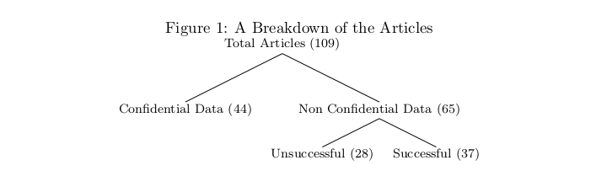
But the biggest problem…

Slide 7
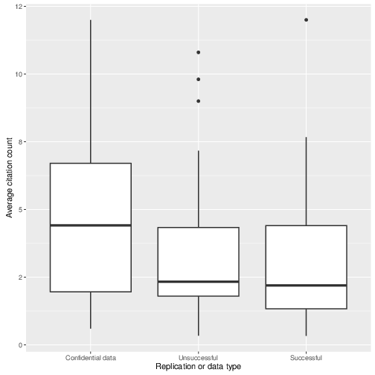
Back to confidential data
Articles using confidential data are (weakly) more cited than others

Slide 8
But: for confidential data…
Data is not available
Metadata is not available
Programs? So-so…

Slide 9

Should We Just Trust These Guys?

Slide 10
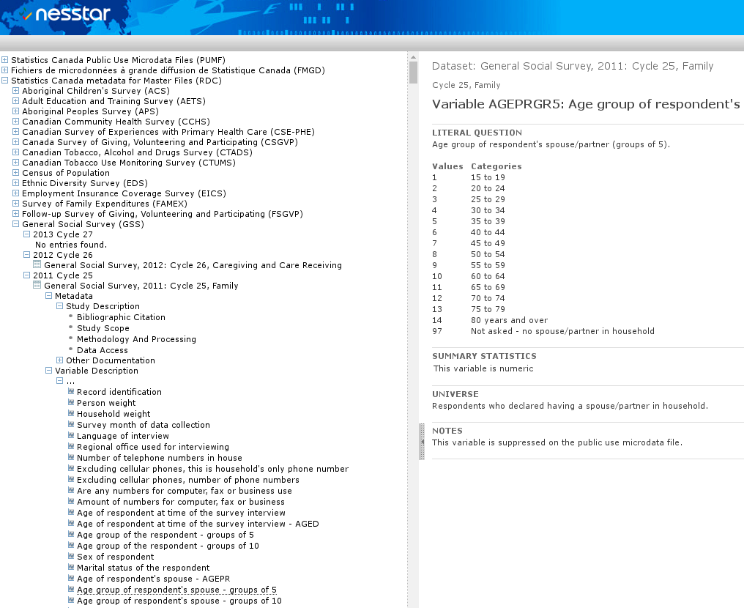
Some are quite commendable

Slide 11
Our original goal
Facilitate documentation of confidential data
Leverage researcher knowledge

Slide 12
Our Approach
Rely on open standards, namely the Data Documentation Initiative (DDI) schema
Provide easy-to-use tools and interfaces to structured metadata
Build infrastructure that enables data curators to leverage community-driven input to official documentation

Slide 13



How?
CED²AR
The Comprehensive Extensible Data Documentation and Access Repository
Notes:
Pronounced /ˈsidər/, like a cedar tree

Slide 14
Progress towards our goals
Facilitate documentation of confidential data
Proposed enhancement of DDI-C to allow for fine-grained access control to information (including variable names)
Software to leverage the standard
Leverage researcher knowledge
Mechanism to allow for crowdsourced or collaborative editing of DDI-C metadata
Metadata curation software
Web-based, extendable DDI editor
Designed for documenting existing datasets (not host data)
Allows for “ASCIImath” notation (in app)
Online at www2.ncrn.cornell.edu/ced2ar-web

Slide 15
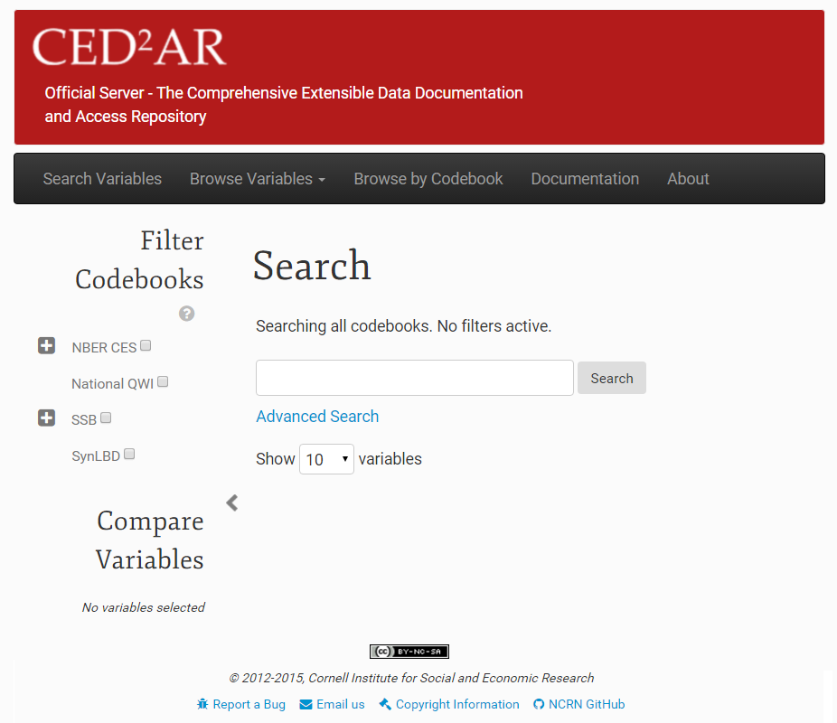
What is CED²AR?
Notes:
Web based, open source, and free for non-commercial use

Slide 16
Basic Information Flow
Staging Area
Public Facing
Official
Metadata
Datasets
Internal
Metadata
User switches
Crowdsourced
Metadata
16
Notes:
Instances of CED²AR are networked together in a distributed system – no centralized repository Three key instances exist for the curation process
An internal server to stage metadata
An official server to publish metadata
A crowdedsourced, or community server open to modifications
Metadata moves between all three instances

Slide 17
Internal Processing
1. Creation of skeletal metadata
Assuming data is already curated
Converting data into standardized metadata
Tools included (for SAS, Stata, SPSS, CSV), not discussed here
2. Hand editing and subsetting
Adding verbose descriptions
Applying disclosure limitation
3. User accessible
These tools can be manipulated by normal users
They could be incorporated into existing workflows

Slide 18
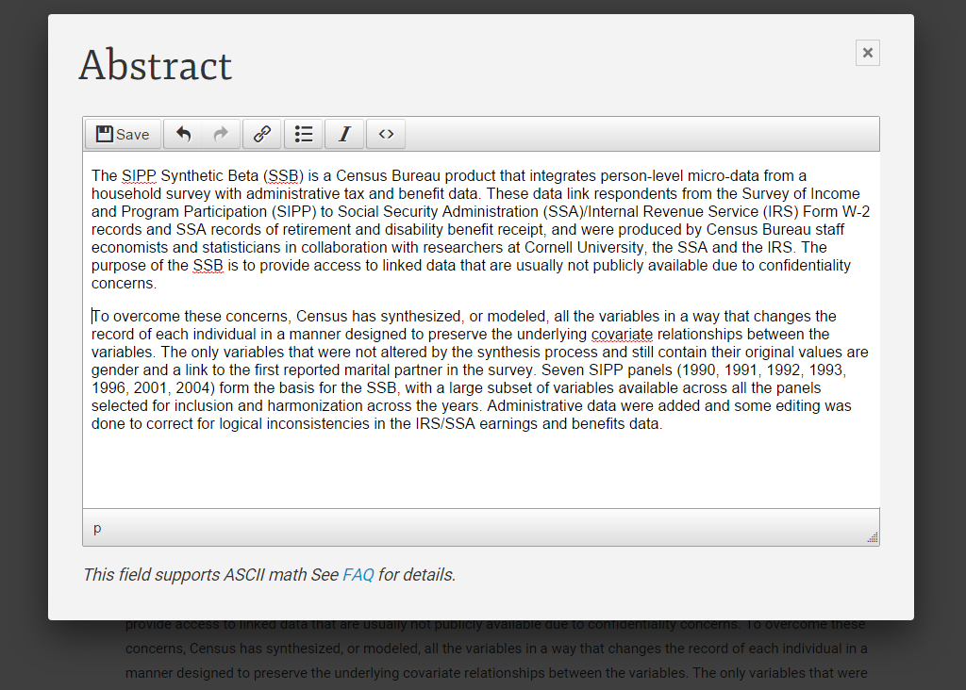
Internal Processing: Hand Editing

Slide 19
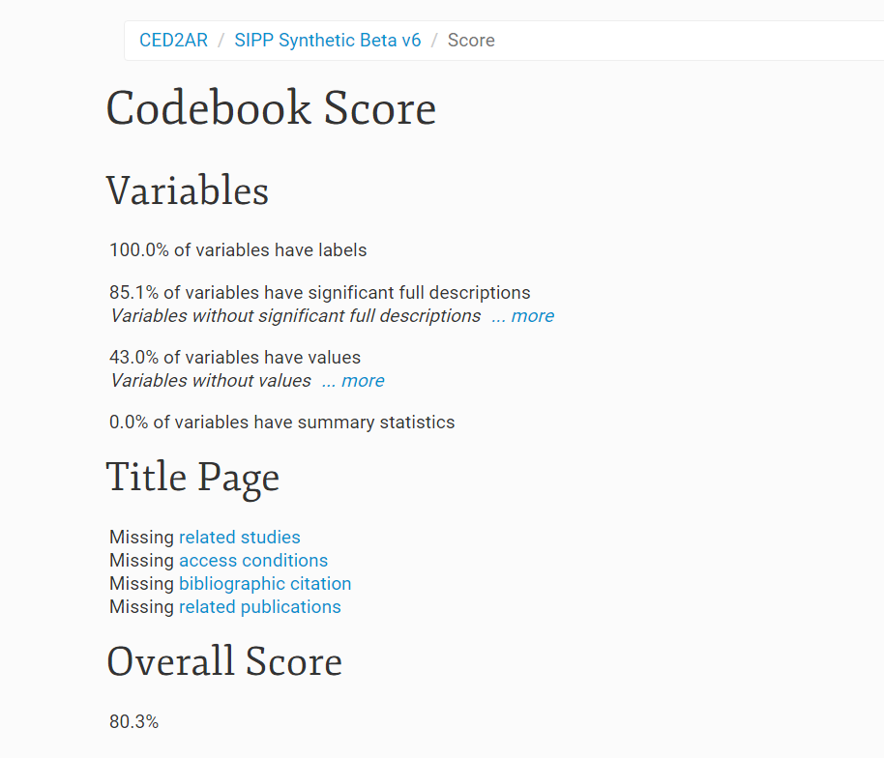
Internal Processing: Scoring
Provide feedback to improve sparse documentation

Slide 20
Fine-grained access controls
Important when working with confidential (meta)data

Slide 21
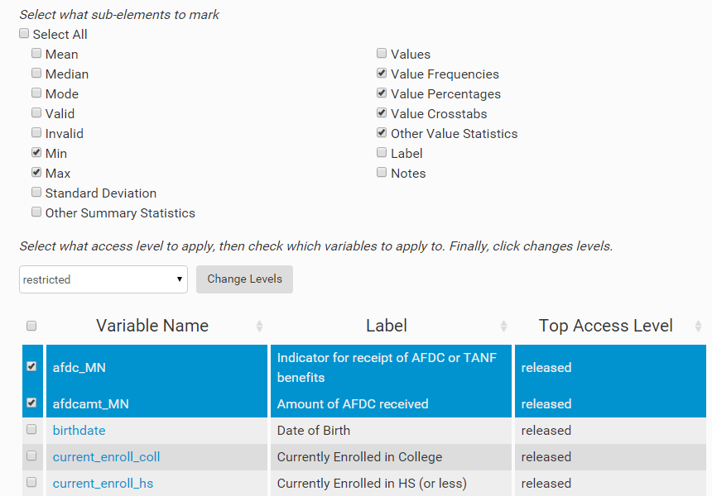
Internal Processing: Access Control
Marking elements with different restrictions
Notes:
Gives users the ability omit specific elements such as summary statistics, and frequencies

Slide 22
Workflow control
Ability to view additions/subtractions
Between versions
Between crowd-sourced information and official information
Ability to control access
Editing versus viewing
Authentication and reputation

Slide 23
Basic Information Flow
Staging Area
Public Facing
Official
Metadata
Datasets
Internal
Metadata
User switches
Crowdsourced
Metadata
23
Notes:
Public facing instances can ingest metadata from staging area on demand

Slide 24
Basic Information Flow
Staging Area
Public Facing
Official
Metadata
Datasets
Internal
Metadata
User switches
Crowdsourced
Metadata
24

Slide 25
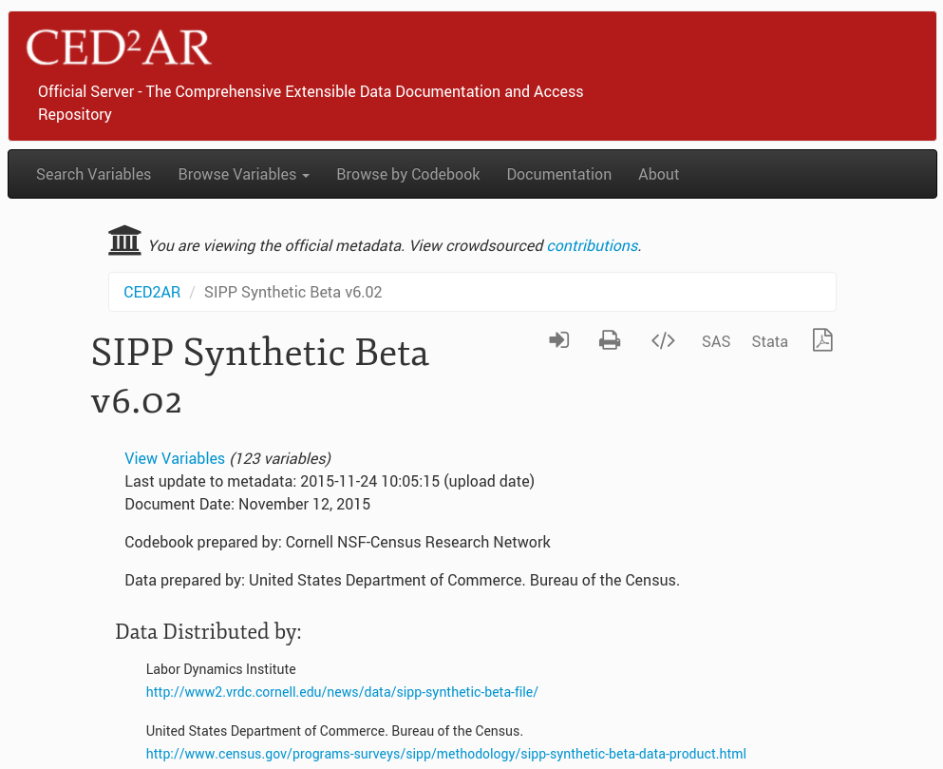
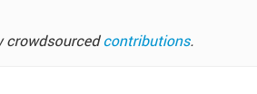
Official view

Slide 26
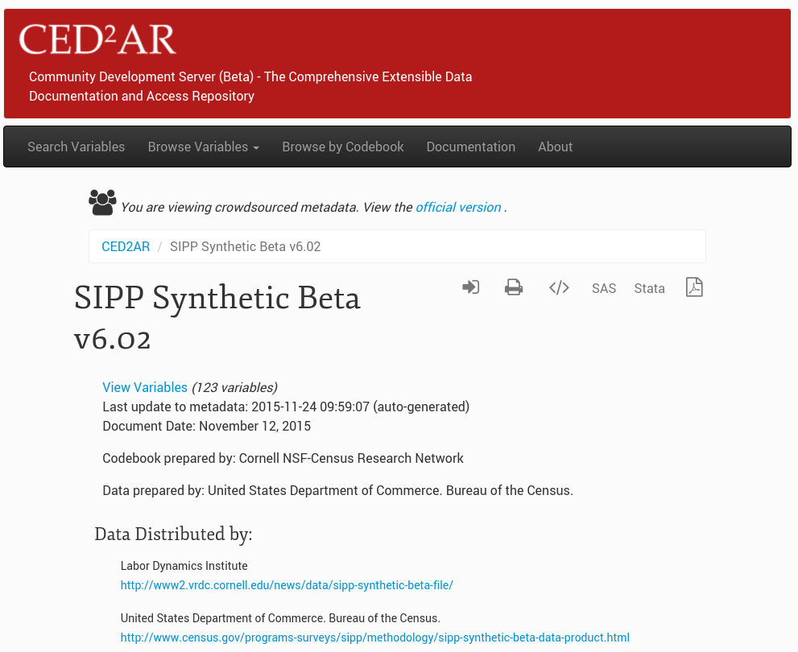

Crowdsourced view

Slide 27
Editing made easy

Slide 28
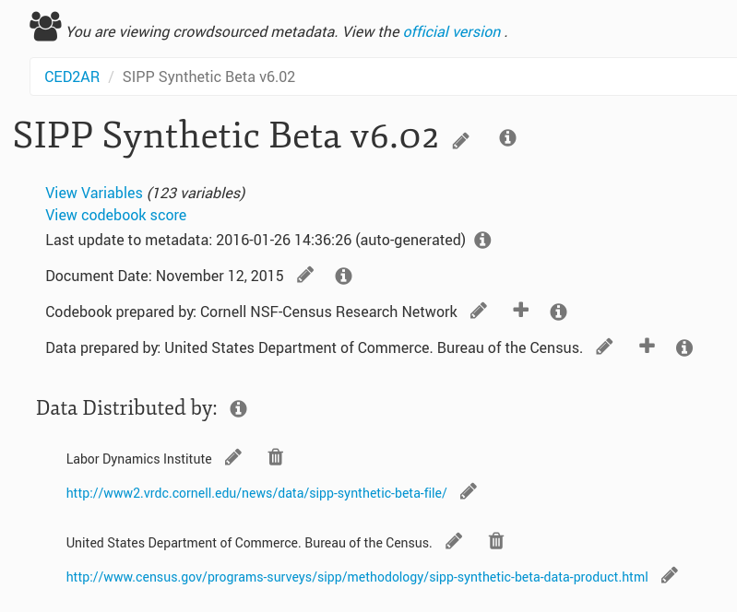

Slide 29
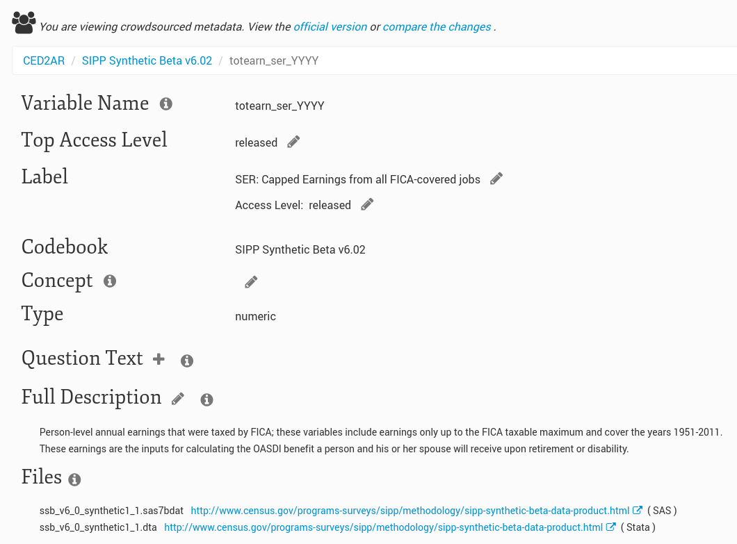

Slide 30
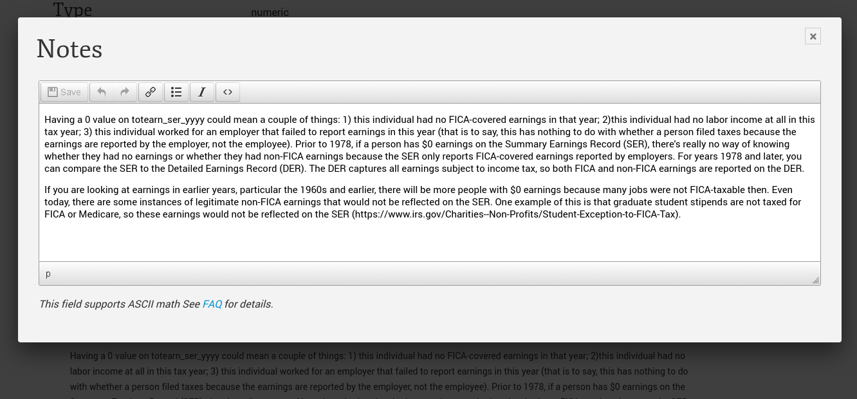

Slide 31
Basic Information Flow
Staging Area
Public Facing
Official
Metadata
Datasets
Internal
Metadata
User switches
Crowdsourced
Metadata
31

Slide 32
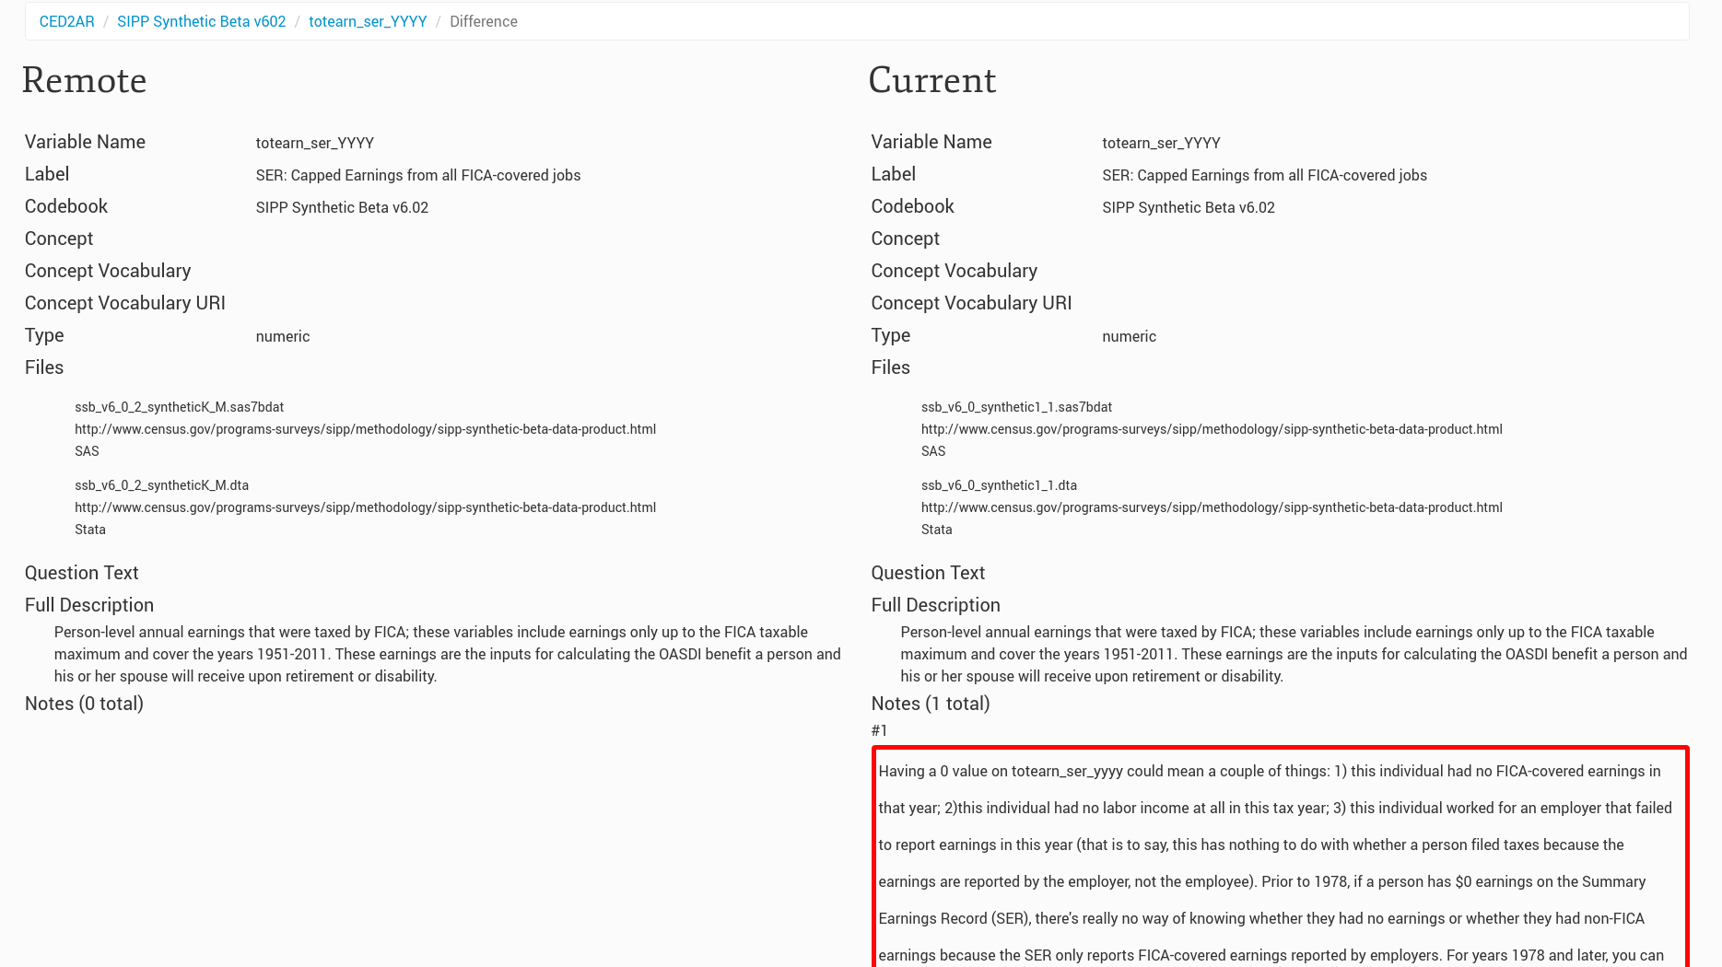
Everybody can see changes

Slide 33
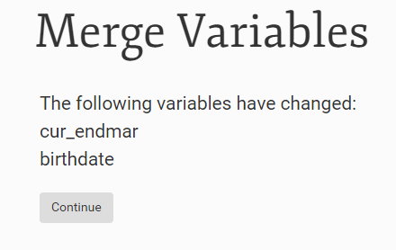
Combining Knowledge: Merging
Curators are given an interface to merge crowdsourced documentation with official

Slide 34
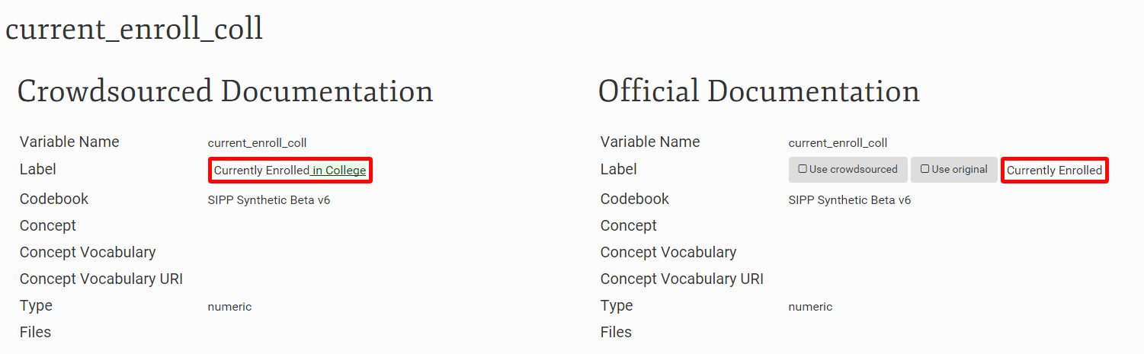
Combining Knowledge: Merging

Slide 35
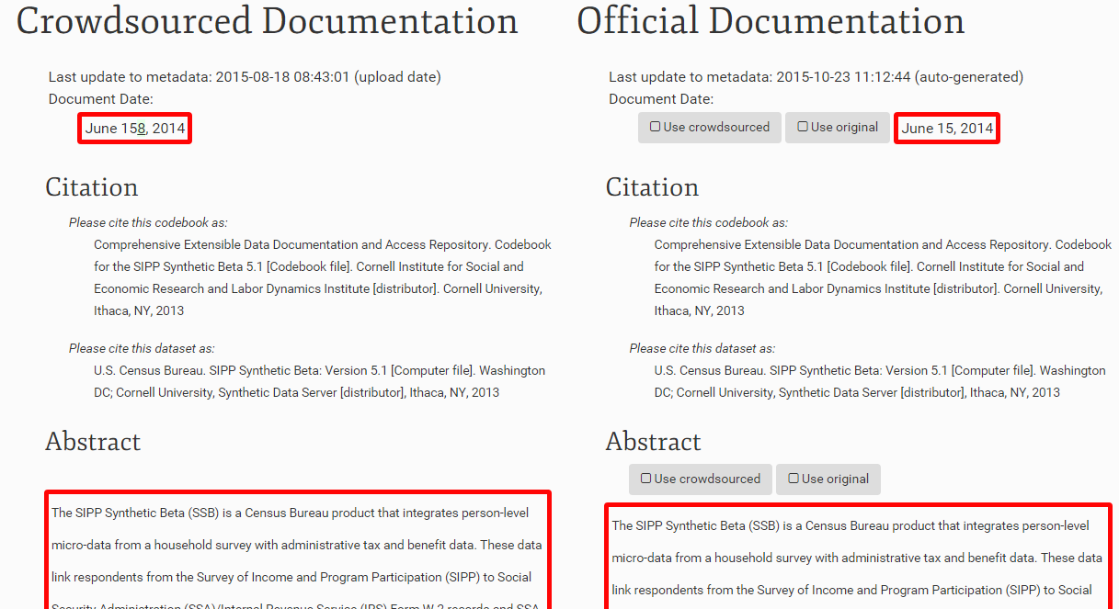
Combining Knowledge: Merging

Slide 36
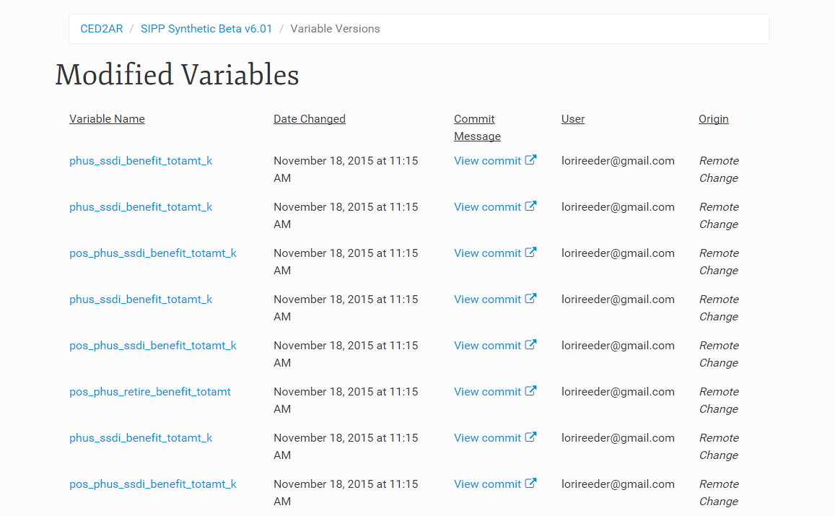
Combining Knowledge: Citations
Contributors can be tracked for each of their changes

Slide 37
That’s the theory…

Slide 38
What works well
Very portable application (self-sufficient package, deployable as desktop app without major programming experience)
Efficient editor for non-technical users (many people like it)
Quite efficient in ingesting large DDI files (tested by ICPSR with large examples)
Native cross-codebook variable search and variable comparison

Slide 39
What doesn’t work so well
Stuck at DDI-C
Configuration cLunkY – in particular for the three-way setup
Scalability an issue
Many codebooks
User interface not optimized
Bugs
Search
UI issues
Local versioning (workgroup scenario)

Slide 40
Implementations and Testing

Slide 41
In active use
Two data products by the Census Bureau
A few demo public-use data products
Common to all: we do not host the data, only the metadata

Slide 42
Kicking the tires
Census Bureau
Collaboration with CARRA as an outside implementation
Discussions with SEHSD for internal implementation (AHS, SIPP)
Discussions with CES for (limited) internal implementation (RDC)

Slide 43
Kicking the tires
ICPSR/ openICPSR
Replacement for internal DDI editor?
Use for openICPSR (for self-serve metadata creation)
mTBI project (Block)

Slide 44
Next steps

Slide 45
Making CED²AR v2 robust
Addition of UTF-8 editing support (Spanish, French, Portuguese, etc.)
Additional fields (link to survey questions, anything within DDI-C)
Bug fixes (search, UI, versioning)

Slide 46
CED²AR V3 Roadmap
Move to relational database – more flexibility wrt schemas (DDI-L, others)
More flexible architecture
standalone modules
Single page application (SPA) for frontend
Redesigned (simpler) VCS

Slide 47
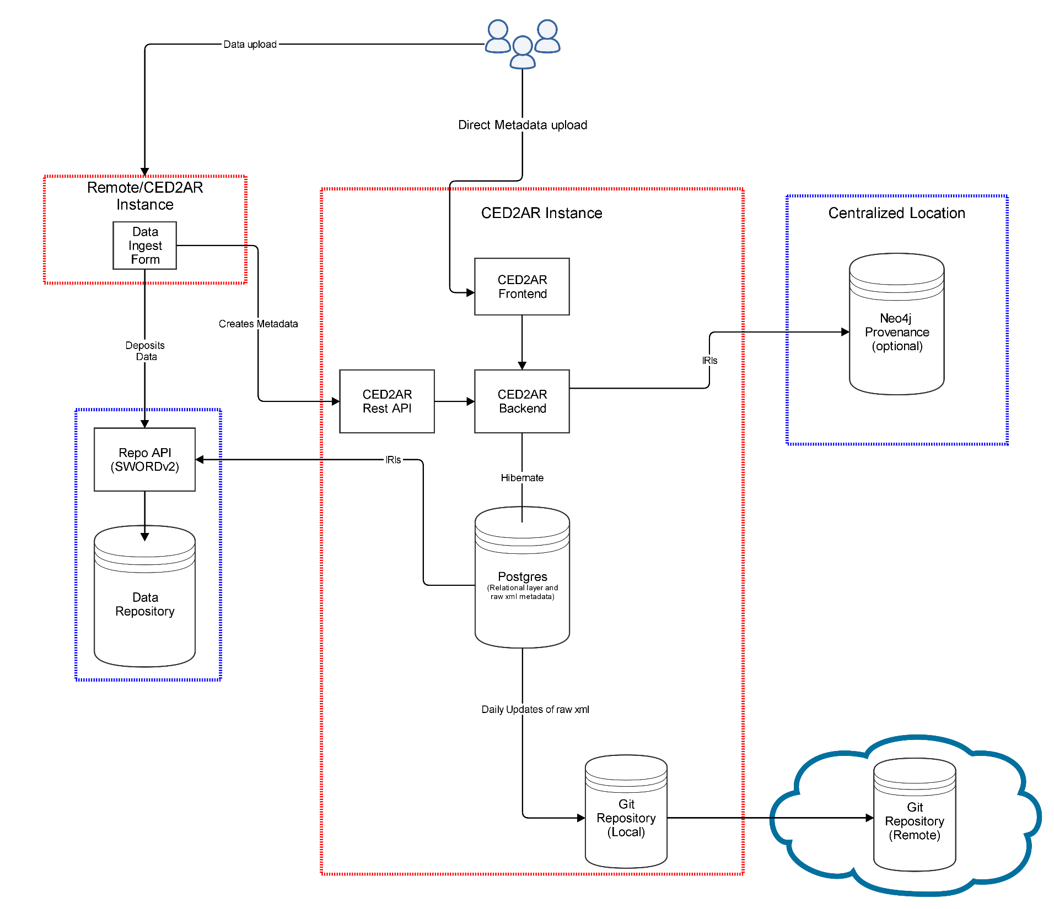

Slide 48
Thank you!
Questions?
ced2ar-pub-dev-l@cornell.edu

